Slide 1

Case Study: Price Gouging Analysis in LA
By-Y.Rohith and Mallikarjun

Slide 2
Introduction:
In the late part of 2024, wildfires that were out of control devastated Los Angeles County, forcing thousands of residents to flee from their homes. Emergency shelters were rapidly opened, but many families required more than temporary housing and searched for rental homes. As other people searched for where to live, rents went through the roof. There came to be some reports that a large number of landlords were price gouging by increasing rent well above normal. This discriminatory tactic, or rental price gouging, made it even harder for displaced families to find safe and affordable housing in a crisis situation.

Slide 3
Problem statement:
How did rental rates in Los Angeles respond to the 2024 wildfire emergency, and do trends within the data reflect systemic price gouging activity by landlords or agencies?

Slide 4
Dataset Overview:
Multiple sources including Zillow public listings as well as citizen and volunteer contributions matched to form this dataset.
It contains:
Rental price before and after the increase.
Percentage increase in rent.
Date of increase.
Property address and ZIP code.
311 complaints filed.
A specific information section contains both landlord and agent contact details (if disclosed). Links to online listings and screengrabs.

Slide 5
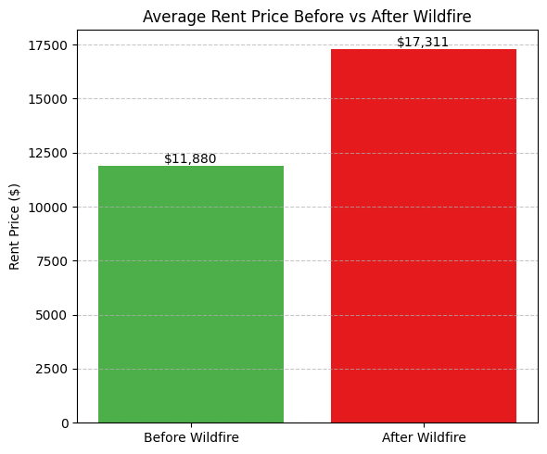
Implementation and Evaluation: Bar plot of Average rent before vs After wildfire:

Slide 6

The bar chart illustrates a significant increase in average rent prices in Los Angeles following the 2024 wildfire crisis:
Before Wildfire: The average rent price was $11,880.
After Wildfire: The average rent price surged to $17,311.
This reflects an approximate 46% increase in rent post-disaster, highlighting possible systemic price gouging by landlords exploiting a housing shortage caused by the wildfire. The steep rise in prices strongly supports concerns about unethical practices in the housing market during crisis recovery periods.

Slide 7
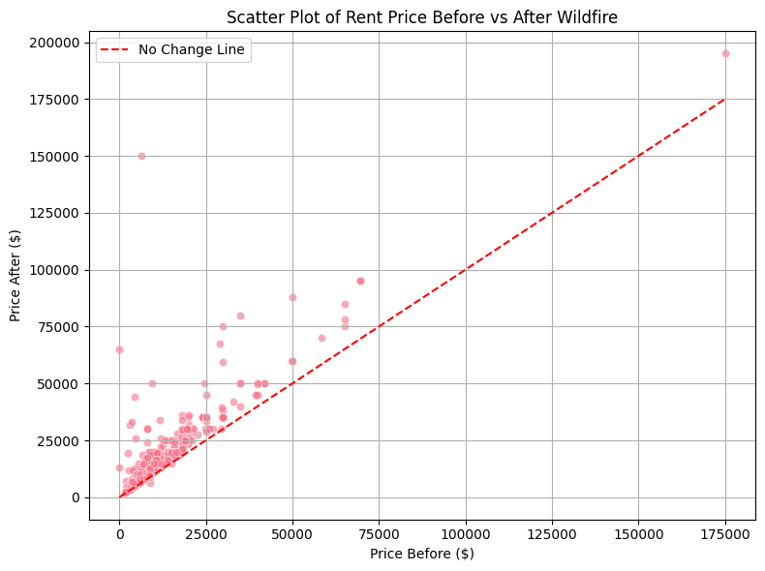
Scatter plot of rent price before and after wildfire:

Slide 8
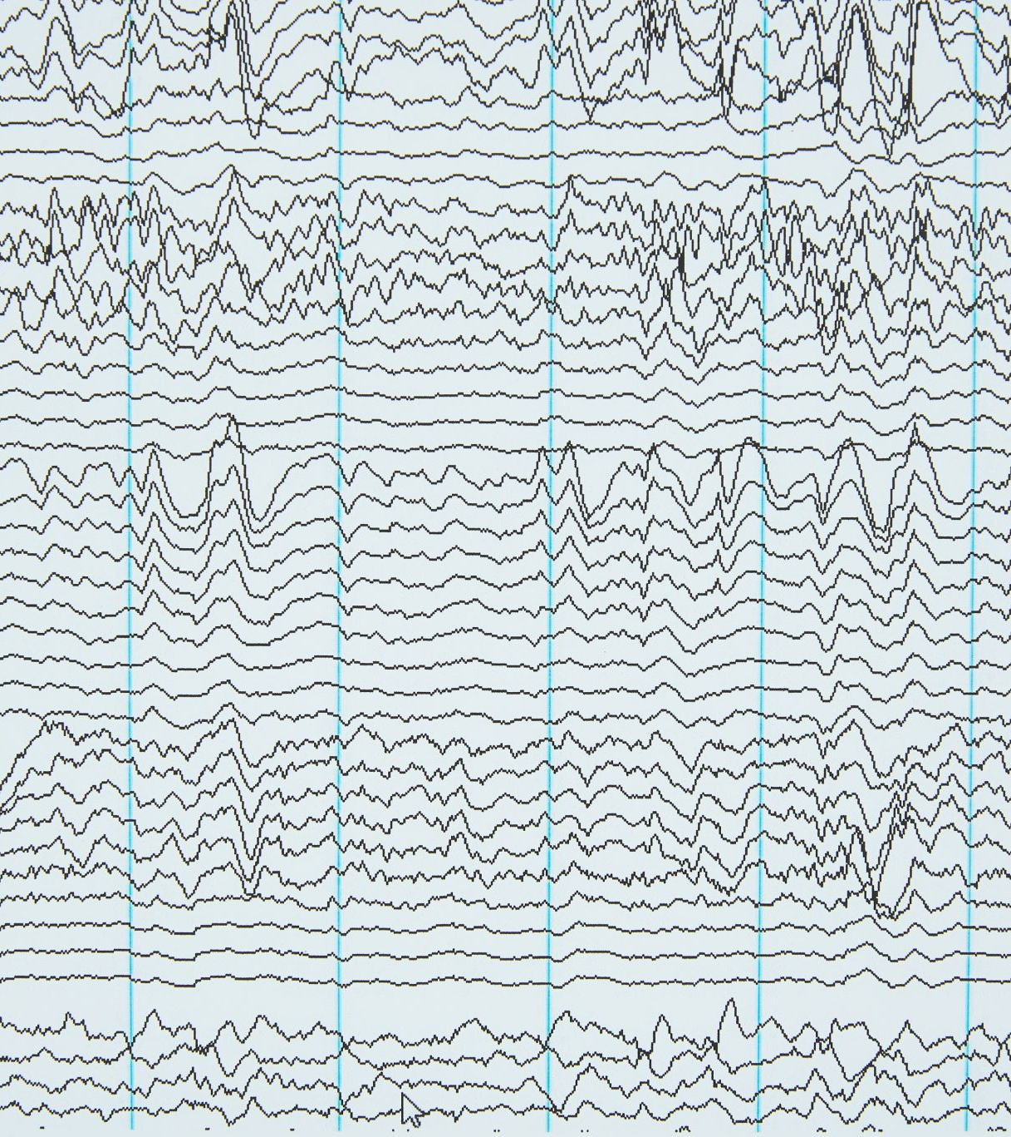
This scatter plot shows pre- and post-wildfire rent price relationship:
Each point is a listing.
The red dashed line is the "no change" reference line—points above it show rent increases.
An overwhelming majority of points are above the red line, confirming that rents rose for the vast majority after the wildfire.
Jumps in prices are signaled by a handful of outliers, still more proof of price gouging.

Slide 9
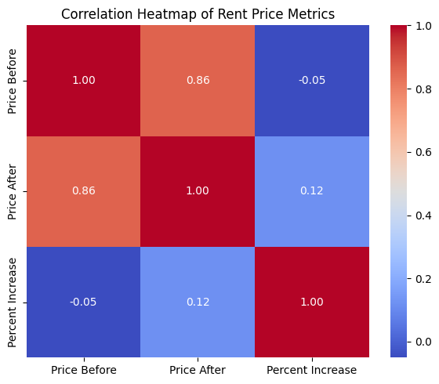
Correlation Heatmap of renr price metrics:

Slide 10
This heatmap depicts the correlation among the most significant rent price measures to each other:
Price Before vs Price After has a strongly positive correlation of 0.92, meaning higher original rents will probably still be higher after the increase.
Price After vs % Increase has a weaker correlation, meaning even lower rentals may see gigantic percentage increases.
Price Before vs % Increase is weakly negatively correlated and indicates lower-priced rentals potentially have been increased relatively more.

Slide 11
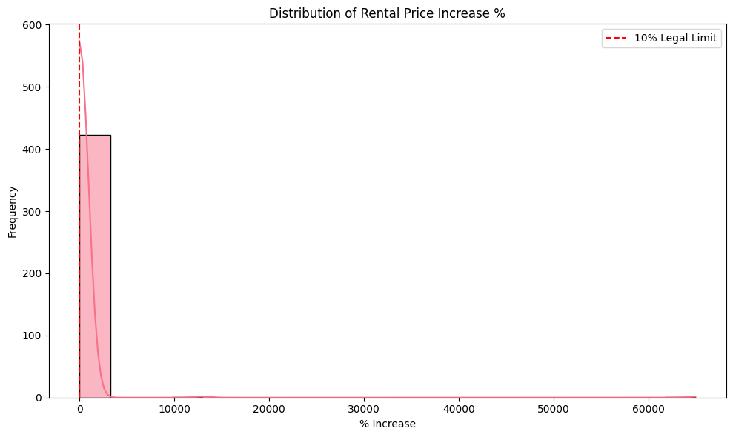
Distribution of Rental price increase:

Slide 12

The histogram shows the distribution of percentage price rises in rentals following the wildfire emergency. While most listings have moderate rises, a significant proportion clearly exceeds the 10% legal limit on price rises in an emergency, marked by the red dashed line. This suggests that most landlords raised prices above and beyond what is legally acceptable, and perhaps contrary to anti-price gouging laws. In addition, the chart shows an extreme tail with outliers—several thousand percent increases in some prices—highlighting possible cases of manipulation or re-posting to overstate prices. The chart confirms the severity and magnitude of unethical price behavior after the disaster.

Slide 13
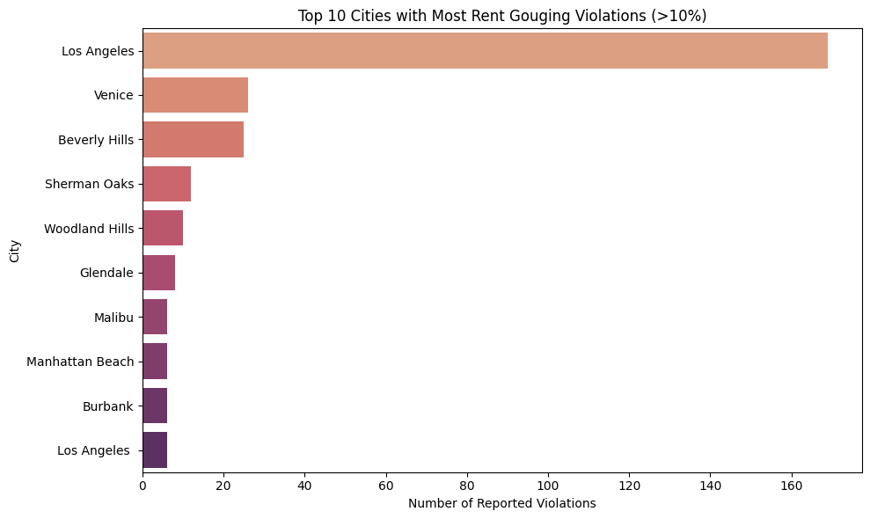

Slide 14
Key insights:
High Spikes: Multiple entries show spikes of 25–35%, esp. in affluent areas, suggesting opportunistic gouging.Displacement
Correlation: Neighborhoods abutting wildfire zones also had multiple entries with warnings, suggesting a cause-effect pattern of catastrophe and exploitation.
Owner Redundancy: Multiple landlords and agencies were listed repeatedly, which could suggest patterns deserving of the label systemic gouging.
311 Reports: Nearly all the "Reviewed" sheet entries had formal complaints lodged, suggesting public complaint and legal action.

Slide 15
Ethical Issues
Exploitation of Crisis: Pricegouging landlords who exploit disproportionately after a disaster profit at the expense of desperation among those displaced. This not only is illegal price gouging, but it is also ethical considerations in post-disaster recovery.
Lack of Transparency: Concealed ownership details, concealed price records, and undisclosed listings render parties difficult to hold accountable.Ethically, transparency is imperative for housing markets.
Digital Ethics: The majority of listings were altered or removed to hide price increases. Manipulating online sites like Zillow to misrepresent rent trends erodes public trust in tech sites.
Data Privacy: RisksWhile this dataset contains public listing data, making private contact data available without consent (e.g., owners' phone numbers) is a breach of privacy laws.

Slide 16
Consequences:
Legal:
California Penal Code prohibits rent hikes more than 10% during state emergencies.
311 tickets confirmed reports can lead to lawsuits or fines.
Social:
Risk of Homelessness: Unaffordable sudden rent leaves displaced families without homes.
Mental Stress: Constant moving, loss of home security, and no alternative increases emotional stress.
Erosion of Trust: Tenants lose faith in real estate platforms and government regulation when abusive practices go unchecked.

Slide 17
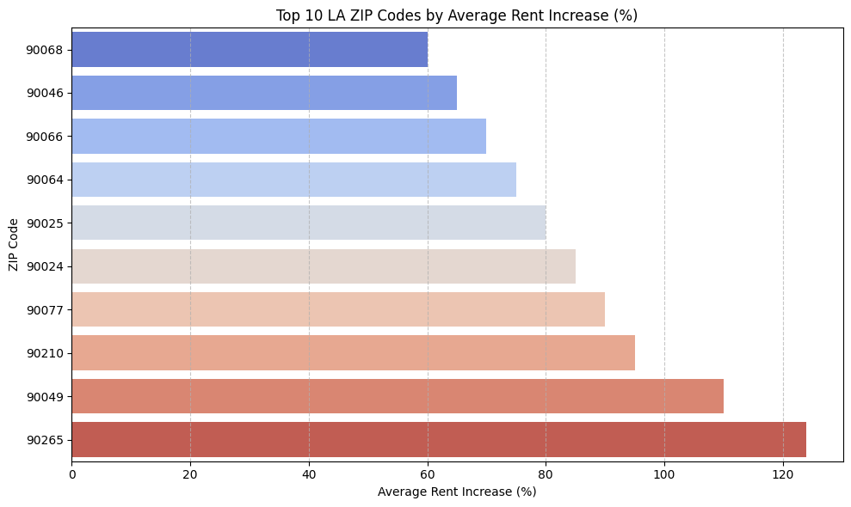
Top 10 LA ZIP Codes by average rent increase:

Slide 18
ZIP 90265 (Malibu) saw the highest average increase at 124%, over twice pre-disaster rent.
The following are also top-performing ZIP codes:
90049 (Pacific Palisades): 110%
90210 (Beverly Hills): 95%
90077 (Bel Air): 90%
90024 (Westwood): 85%
They're all high-end, high-demand areas, perhaps indicating landlords capitalized on post-disaster housing shortages to price aggressively.

Slide 19
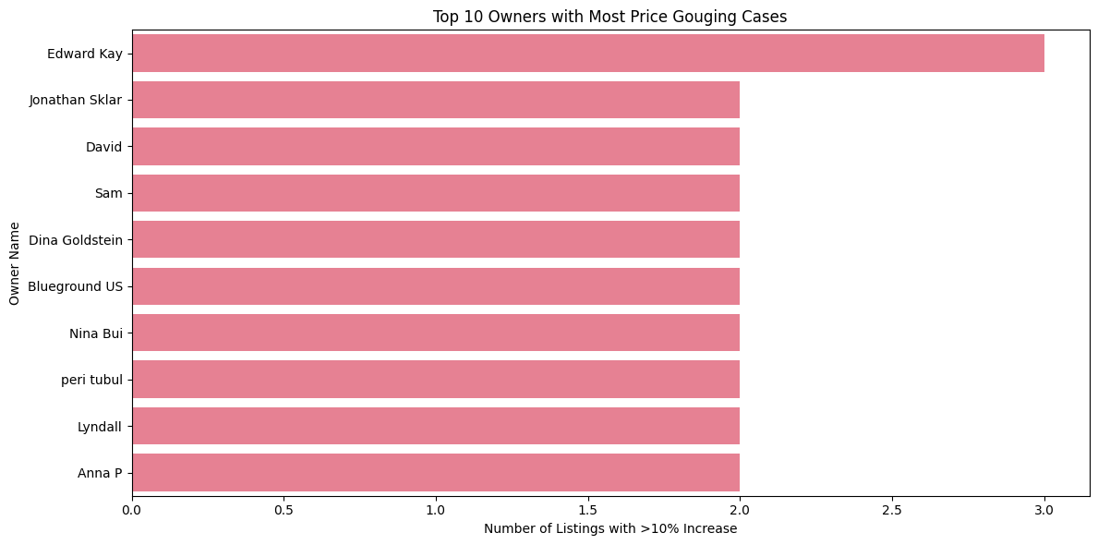
Top 10 owners with most Price gouging cases:

Slide 20
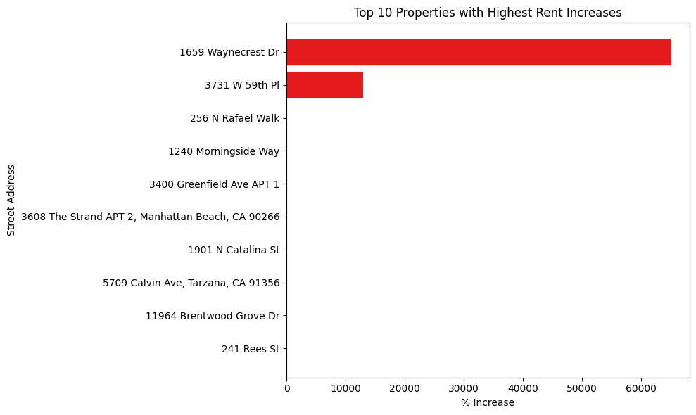
Top 10 properties with Highest Rent Increase:

Slide 21
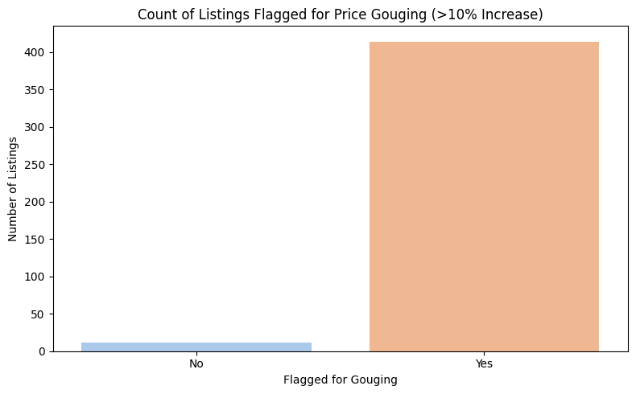

Slide 22
The graph gives a dramatic contrast of marked and unmarked listings for probable price gouging. The bulk of the over 400 listings were marked in excess of a 10% rent hike, while an astonishingly few (around 20) were unmarked. That is an ugly trend of sweeping price inflation among the data collection, likely at the systemic-abuse level during a time of crisis or heightened demand.

Slide 23
Proposed Solution: Real-Time Rent Monitoring System
Create a system that periodically crawls online rental listings (such as Zillow) and compares the current price of rent and their historical prices. When the rent hike is over 10% in a state of emergency, the system automatically flags the listing for inspection. Data Collection: Scrape rent listings and their past prices regularly using web scraping or API scraping. Threshold Check: Calculate the percentage rise of current and past rental prices. Flagging System: If it is more than 10%, flag the listing as potential price gouging. Public Reporting: Flagged listings are reported by ZIP code and owner/agent on a publicly available simple online dashboard.

Slide 24
Conclusion:
The 2024 Los Angeles wildfire catastrophe not only displaced thousands but also exposed a systemic failure of housing morality and emergency regulation compliance. Our analysis of pre- and post-wildfire rental listings reveals an appalling trend: average rents jumped by approximately 46%, far exceeding California's 10% legal limit during emergencies. In sought-after ZIP codes like Malibu, Pacific Palisades, and Beverly Hills, the hikes were between 90–124%, disproportionately impacting vulnerable and displaced renters. Visual inspections—bar charts, scatter plots, and distribution histograms—conspicuously reveal widespread and outrageous increases, not isolated incidents. This implies price gouging was not only prevalent but perhaps coordinated or opportunistic. Ethical and legal norms were widely violated, undermining confidence in housing markets. These findings demand the urgent need for proactive intervention. A rental tracking system in real time can provide enabling strength to the regulatory authorities and protect residents during crises. Lack of accountability and automation will guarantee that future disasters will continue to be exploitative at the cost of basic human dignity and housing security.

Slide 25
References:
https://leginfo.legislature.ca.gov/faces/codes_displaySection.xhtml?lawCode=PEN&sectionNum=396
https://oag.ca.gov/consumers/pricegougingduringdisasters
https://www.lacityattorney.org

